Slide 1
266 Natural Language Processing
Week 9: Entities and Linking

Slide 2
This Week
Goals
Why should we care about entities in text?
How can we identify and extract all the ways we refer to entities in text?

Slide 3
Peeking Ahead
Week 1: Introduction
Week 2: Text Classification
Week 3: Language and Context
Week 4: Pretrained Transformers
Week 5: Text Generation Models
Week 6: Machine Translation
Week 7: Question Answering & Summarization
Week 8: Linguistic Representation
Week 9: Entities and Linking
Week 10: Embedding-based Retrieval
Week 11: Multimodality in NLP
Week 12: ML Fairness and Privacy
Week 13: NLP in the Real World

Slide 4
Announcements
Assignment 3 (Various) - Due this past Sunday 3/3
(Tuesday 3/5 if you use late days)
Assignment 4 (MM) to be released Friday 3/8
Final assignment
Project -
Feedback complete
Projects - Due 04/14 (hard deadline)
5 - 6 WEEKS
Questions?
Concerns?

Slide 5
Announcements
Paper reading sessions:
WebGLM: Towards An Efficient Web-Enhanced Question Answering System with Human Preferences
Jennifer: Monday 03/04 5:30 PST
Unlocking Practical Applications in Legal Domain: Evaluation of GPT for Zero-Shot Semantic Annotation of Legal texts
Mark: Tuesday 03/12 5:30 PST
Notebook walkthrough sessions:
TBD
Concerns?

Slide 6
The Plan
Structure of Class
Project Check in
Key Learning Review
Information Extraction
Named Entity Recognition
Entity Resolution
Entity Linking
Coreference Resolution
Relation Extraction

Slide 7
Project check-In
Who has their data? (hopefully, everybody)
Who has a baseline? (most groups?)
Experiments to improve baseline?
Analysis?
Problems?
If you want to turn in an optional draft of your paper you’ll need to get it to the instructors by 03/18. We’ll review and get back to you either via email or in office hours the following week.

Slide 8
Key Learnings Review
Entities and Linking

Slide 9
NLP Review
How can we use a BERT model to label parts of speech in a sentence?
What are some key differences between a dependency parse tree and a phrase-based parse tree?

Slide 10
Information Extraction and Grounding
Entities and Linking

Slide 11
What Is Information Extraction?
Given these two sentences:
On the afternoon of November 19, 1863, Lincoln went to Gettysburg. He gave his famous speech there.
What information can we extract from these two sentences?

Slide 12
What Is Information Extraction?
Given the sentences:
On the afternoon of November 19, 1863, Lincoln went to Gettysburg. He gave his famous speech there.
EXTRACT:
Time: “afternoon”
Date: “November 19, 1863”
Person: Lincoln
Location: Gettysburg
Pronominal co-reference: He
Wikipedia link: Abraham Lincoln article
Wikipedia link: Gettysburg, PA article
Relations: between entities to add to knowledge base

Slide 13
Information Extraction Tasks
IE is an umbrella term encompassing multiple tasks:
Named entity recognition and mention detection: identify named entities in text and all references to entities
Entity resolution: disambiguate those entities
Entity linking: link to real-world counterparts
Coreference resolution: disambiguate mentions and cluster references to the same entity
Relation extraction: identify relations between entities in text

Slide 14
The Grounding Problem
So far in the course, low-level NLP: everything ungrounded
manipulate text strings, but no idea what it means
“red” = , “cat” = 🐱
Information Extraction starts (partly) to resolve this
Deal with entities. Can ground to “real world.”
Entity recognition: identify entities (“NER”)
Resolution: ground identified entities
Coreference: recognize mentions that refer to entities
Relation extraction: describe entities

Slide 15
Caveats / Limitations of IE
IE != full semantic understanding
Only try to understand parts of language: entities and their surroundings and specific relationships between the entities.
Ex: building a knowledge base - OK to have low per-sentence recall
Can extend extraction further:
Semantic Role Labeling (predicate-argument relation structures)
Semantic Parsing (build on entity recognition + SRL)
Multi-modal models (text + images)
Grounding of “concepts” (e.g. “red” = , “cat” = 🐱)

Slide 16
Named Entity Recognition
Entities and Linking

Slide 17
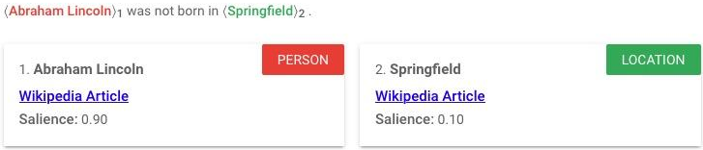
Named Entity Recognition Example
Task: Find things, assign them a coarse type.
Source: https://cloud.google.com/natural-language

Slide 18
Named Entity Recognition Example
Given the sentences:
On the afternoon of November 19, 1863, Lincoln went to Gettysburg. He gave his famous speech there.
Time: “afternoon”
Date: “November 19, 1863”
Person: Lincoln
Location: Gettysburg

Slide 19
Tagging Schemes
BeginInsideOutside (BIO) schemes are effective for labeling any sequence
Word | POS | Phrase | NER
Abraham | NNP | B-NP | B-PER
Lincoln | NNP | I-NP | I-PER
was | VBD | B-VP | O
elected | VBN | I-VP | O
President | NNP | B-NP | O
in |  | B-PP | O
1860 | CD | B-NP | B-DATE
. | PUNC | O | O
Notes:
Abraham Lincoln
[Abraham, Lincoln]
[Abr-, -ah-, -am, Li-, -col-

Slide 20
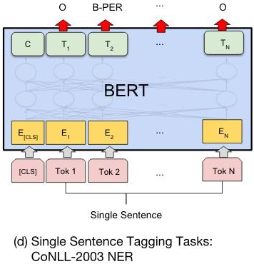
How to Predict NER Labels?
Pretrained transformer
Leverage self-attention to generate embedding for each token in sequence
Output layer assigns BIO tag to each token
examples
Image source: Devlin et al. BERT: Pretraining of deep bidirectional transformers for language understanding. https://arxiv.org/pdf/1810.04805v1.pdf

Slide 21
Entity Resolution
Entities and Linking

Slide 22
Entity Resolution
Disambiguation: convert string to some unambiguous canonical form
Which Lincoln? (president or other individual)
Which Tuesday?
Which Georgia? (state or country)

Slide 23
Entity Resolution Example
Given the sentences:
On the afternoon of November 19, 1863, Lincoln went to Gettysburg. He gave his famous speech there.
Time: “afternoon” -> 15:00
Date: “November 19, 1863” -> 18631119
Person: Lincoln -> Abraham Lincoln
Location: Gettysburg -> 39°49′42″N 77°13′56″W
What kinds of canonical representations can we use for these entities?

Slide 24
Entity Linking
Entities and Linking

Slide 25
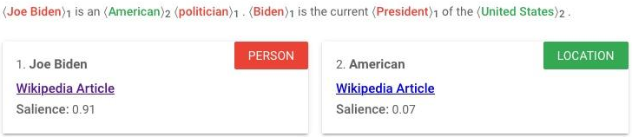
Entity Linking
Goal: resolve different mentions of the same entity and link to DB entry
Mention: a single “chunk” (an instance of a word symbol)
Entity: a grounded “thing” (the concept-thing)

Slide 26
Entity Linking Example
Given the sentences:
On the afternoon of November 19, 1863, Lincoln went to Gettysburg. He gave his famous speech there.
What might we link to besides Wikipedia articles?
Person: Lincoln
https://en.wikipedia.org/wiki/Abraham_Lincoln
Location: Gettysburg
https://en.wikipedia.org/wiki/Gettysburg,_Pennsylvania

Slide 27
Coreference Resolution
Entities and Linking

Slide 28
Coreference Resolution
Linguistics note: “anaphora resolution”
Anaphora: expression depends on antecedent
“Sally arrived, but nobody saw her”
Cataphora: expression depends in postcedent
“Before her arrival, nobody saw Sally”
Other types of referents:
Exophora: external context (maybe unresolved)
“He was standing over there”

Slide 29
Coreference Resolution Example
Given the sentences:
On the afternoon of November 19, 1863, Lincoln went to Gettysburg. He gave his famous speech there.
Person: Lincoln
Location: Gettysburg
Pronominal co-reference: He
Co-reference: there

Slide 30
Brainstorming: How to Resolve
Example: “General Electric said the Postal Service contacted the company to... ”
Discussion: What does ‘company’ refer to? How could this be approached programmatically?
(Assume no parse trees, POS/NER tokens...)
...
…

Slide 31
Coreference Resolution Task
Two steps
Identify all mentions (spans)
Entities
Pronouns
Noun phrases
Aggregate like mentions
Cluster mentions of same entities

Slide 32
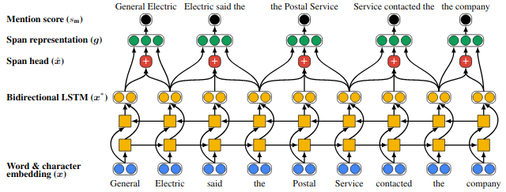
Neural (Pre-BERT) Coreference Resolution
No hand-coded features with two processing stages
Stage 1 of 2
Identify spans.
Score potential entity mentions.
Prune low-scoring candidates.
Source: End-to-end Neural Coreference Resolution

Slide 33
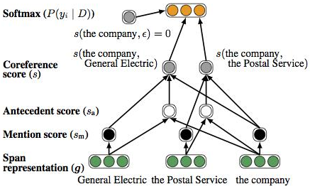
Neural (Pre-BERT) Coreference Resolution (cont.)
No hand-coded features (cont.)
Stage 2 of 2
Score pairs of spans.
Keep highest scoring pair.
Source: End-to-end Neural Coreference Resolution

Slide 34
Neural Coreference Resolution with BERT
Replace bi-LSTMs with BERT
Use BERT to generate span representations within independent segments of documents
Concatenate BERT embedding for first and last word piece in span
Combine with iteratively recomputed attention vector for span “head” based on antecedent distribution
Calculate score for each mention (span) and probability that two spans refer to same entity
BERT for spans? Sure. Works ok.
Where else have we used BERT to represent spans?
Does BERT know anything about spans? Can we improve it?
Antecedent distribution introduced by Lee et al. (2018) Updated bi-LSTMs with BERT in Joshi et al., 2019
Notes:
Better improvement for BERT-large vs BERT-base

Slide 35
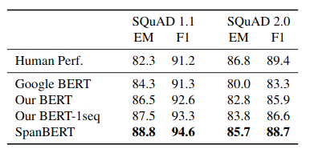
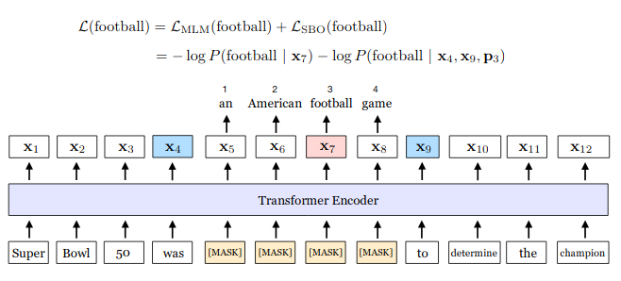
Even Better: SpanBERT
Targeted BERT-like model pre-trained for span-type problems
SpanBERT training
Insight: mask spans and add span-related training objectives!
Source: SpanBERT in Joshi et al., 2019

Slide 36
Relation Extraction
Entities and Linking

Slide 37
Relation Extraction
Identify triples of two entities or mentions and the relation between them
Multiple approaches
Rule-based
Fully supervised
Semi-supervised
Unsupervised
Generative - One Shot

Slide 38
Relation Examples
Binary relation: relational triple (e_1, relation, e_2)
(Abraham Lincoln, went-to, Gettysburg, PA)
(Abraham Lincoln, gave-speech, 1863-11-19)
Many relations are not binary
“<company> appointed <person> as <position>”
But often can decompose
(<person>, employed-by, <company>)
(<person>, has-job-title, <position>)
(<company>, uses-job-title, <position>)

Slide 39
Relation Extraction Example
Given the sentences:
On the afternoon of November 19, 1863, Lincoln went to Gettysburg. He gave his famous speech there.
(Abraham Lincoln, went-to, Gettysburg, PA)
(Abraham Lincoln, went-on, 1863-11-19)
(Abraham Lincoln, spoke-in, Gettysburg, PA)

Slide 40
Fully Supervised Relation Extraction
TACRED: large dataset of sentences labeled with subject and object and 42 typed relations including no_relation
Example | Entity types and label
Carey will succeed Colleen P. Black, who held the position for 15 years and will take on a new role as chairwoman of Hearst Magazines, the company said. | Types: person/title Relation: per:title
Irene Morgan Kirkaldy, who was born and reared in Baltimore, lived on Long Island and ran a child-care center in Queens with her second husband, Stanley Kirkaldy. | Types: person/city Relation: per:city_of_birth
Baldwin declined further comment and said JetBlue chief executive Dave Barger was unavailable. | Types: person/title Relation: no_relation

Slide 41
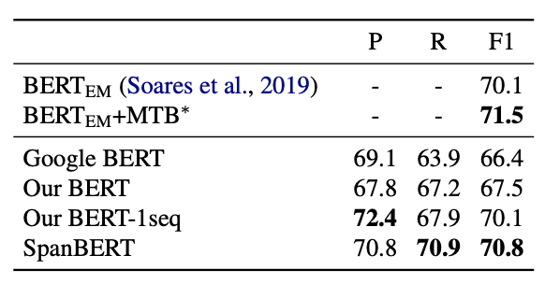
Fully Supervised Relation Extraction
Example | Entity types and label
Irene Morgan Kirkaldy, who was born and reared in Baltimore, lived on Long Island and ran a child-care center in Queens with her second husband, Stanley Kirkaldy. | Types: person/city Relation: per:city_of_birth
per:city_of_birth
“[CLS] [SUBJ-PER] , who was born and reared in [OBJ-LOC] , lived …”
Classifier on top of CLS token predict relation label
Produces near SOTA 70.8 F1 score
SpanBERT

Slide 42
Unsupervised Relation Extraction
ReVerb system simple rules for relation identification:
Takes POS and entity Chunked sentence as input:
For each verb in sentence, start at verb and take longest sequence of words that satisfies lexical and syntactic constraints
For each relation phrase identified in step 1, find nearest noun phrase to the left that isn’t a relative pronoun, WHO-adverb, or existential “there” then nearest noun phrase to the right
Run classifier that scores confidence in candidate triple

Slide 43
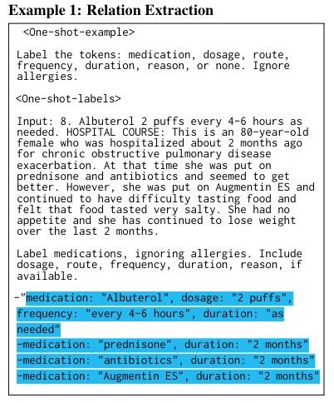
One Shot Clinical Information Extraction
Provide large LLM with prompt, instructions, example input and example output
LLM is able to parse example and emit structured data
Source: Large Language Models are Few-Shot Clinical Information Extractors

Slide 44
Notebook Walkthrough
Entities and Linking

Slide 45
Paper Peeks/Recent Advances/Challenges
Entities and Linking

Slide 46
Recent Papers
Revisiting Relation Extraction in the era of Large Language Models

Slide 47
Extras
Entities and Linking

